Slide 1
SAP HANA and BI4 authentication

Slide 2
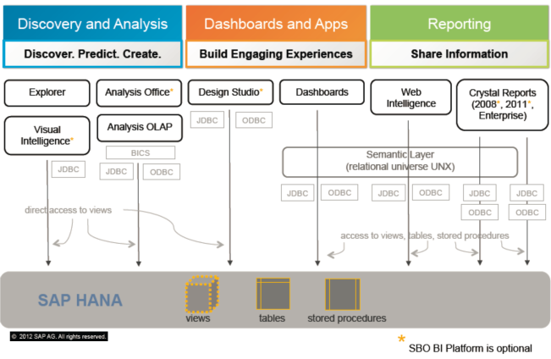

Slide 3
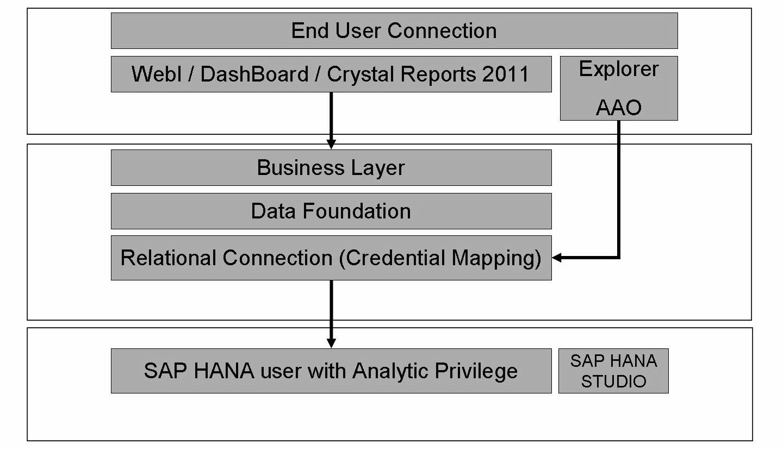
Database Credential Overview

Slide 4
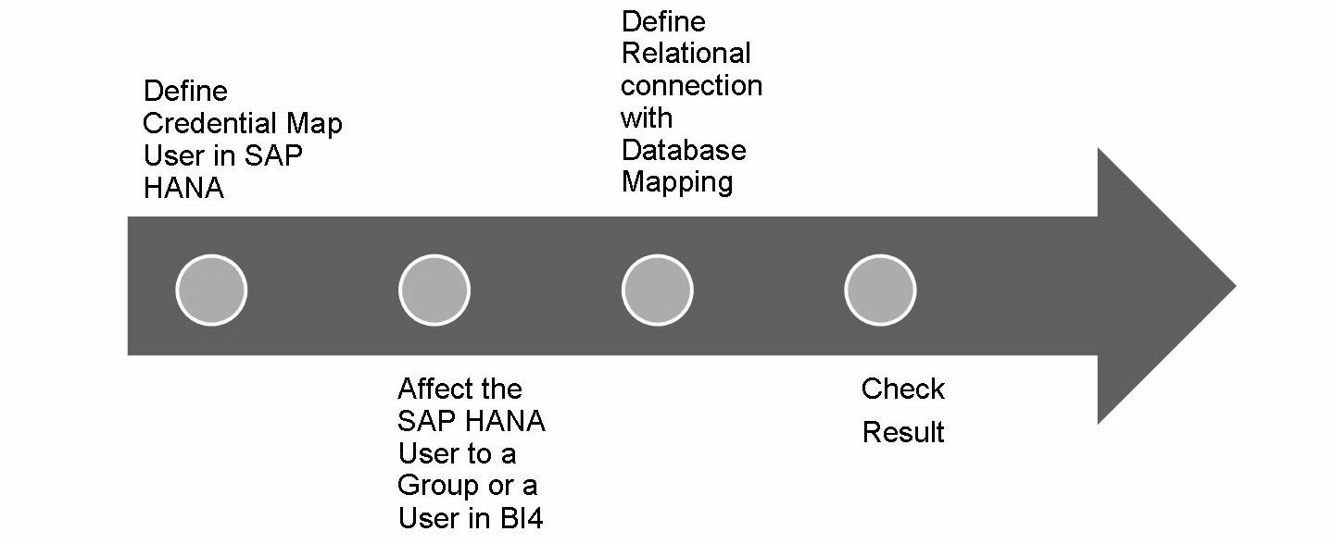
Overall Procedure

Slide 5
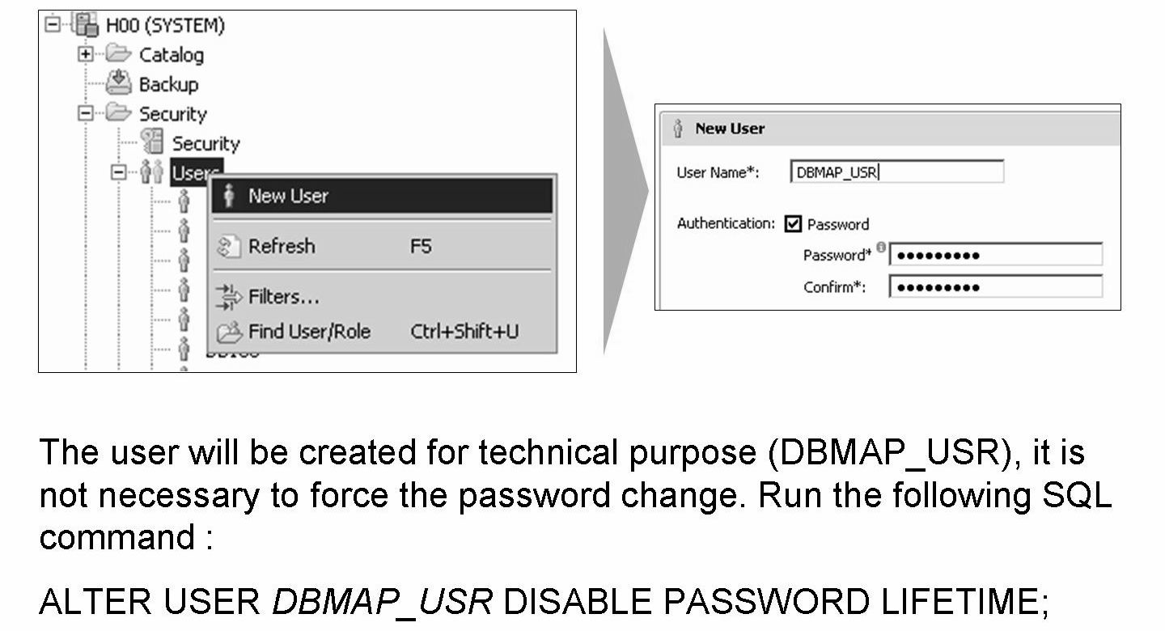
Define Credential Map User in SAP HANA

Slide 6
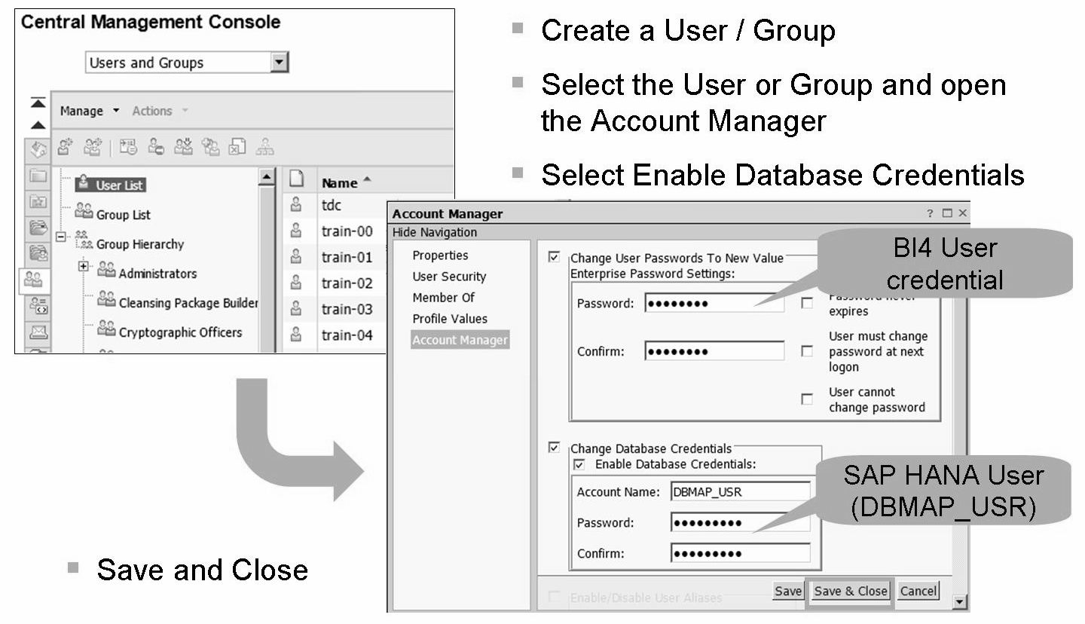
Affect the SAP HANA User to a Group or a User in BI4

Slide 7
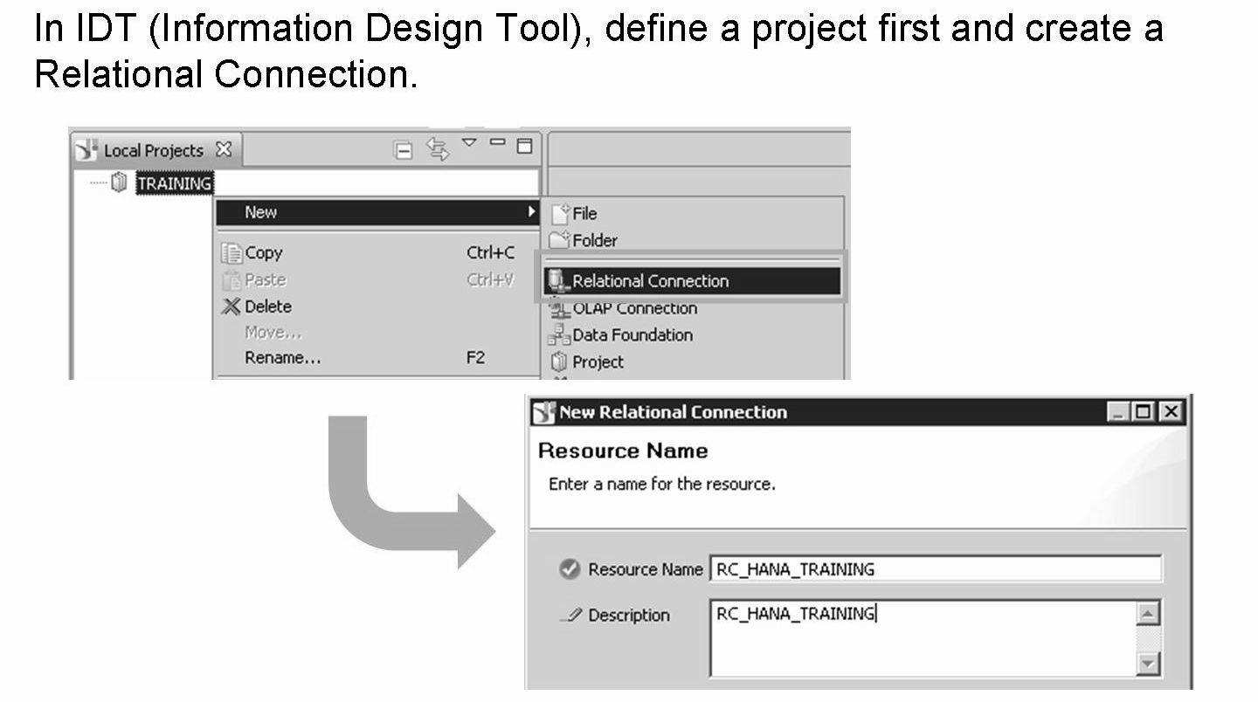
Define Relational connection with Credential Mapping (I)

Slide 8
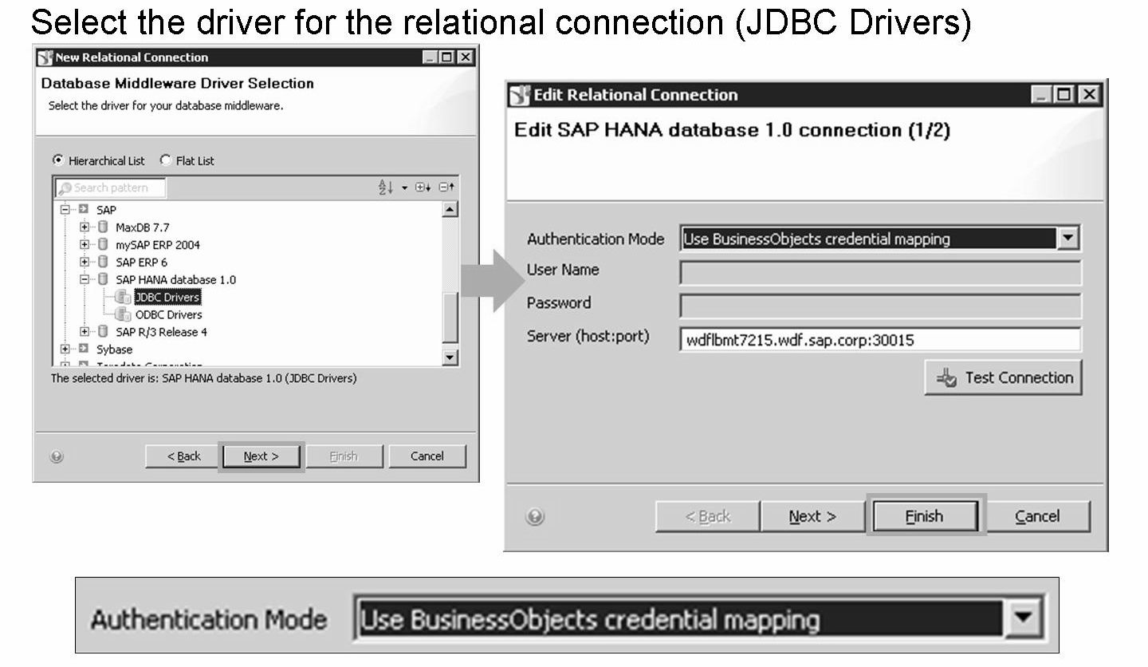
Define Relational connection with Credential Mapping (II)

Slide 9
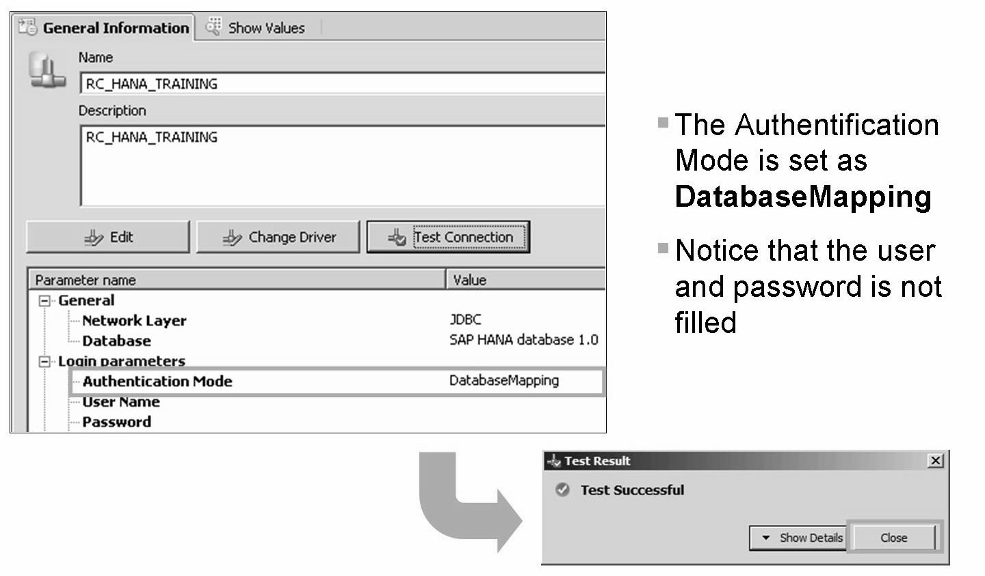
Define Relational connection with Credential Mapping (III)

Slide 10
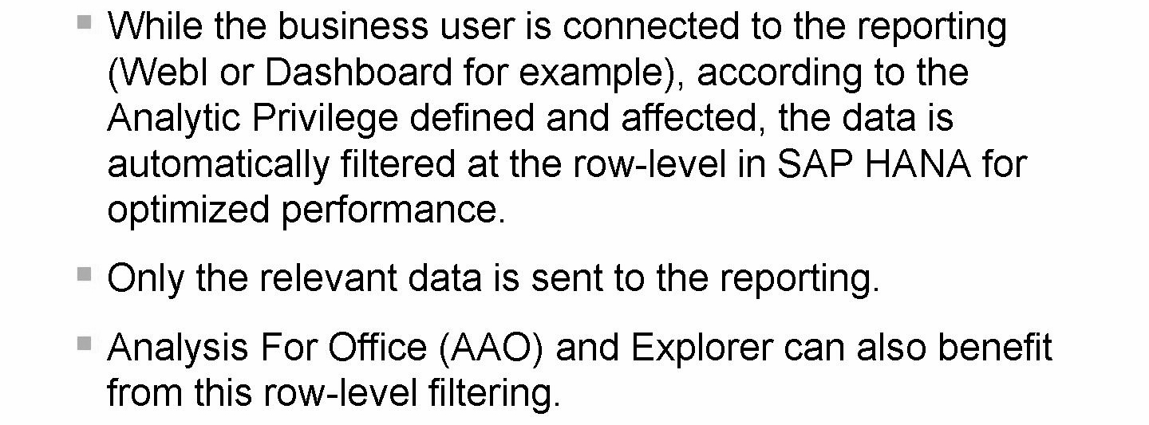
Check Result

Slide 11
THANK YOU
Courtesy : SAP Labs Document -
HA 300 – SAP HANA Implementation and Modeling

